Slide 1


Overvekt og fedme hos barn og unge
Effektiv kostholdsveiledning ved fedme hos barn og unge
-
Samira Lekhal
MD, PhD
Grunnlegger GreeNudge og Re-start.no
Overlege Seksjon for foebyggende medisin, Bærum Sykehus, Vestre Viken
for sykelig overvekt i Helse Sør-Øst
Samira Lekhal

Slide 2


Samira Lekhal
Notes:
Samira som vi allerede har sett. Er kunnskapsfundamentet stort. Vi har jobbet spesielt mye med endring av forbrukeratferd, matvalg
Vi lener oss på tung forskning og bestilte oppsummeringer om hva forbrukere ønsker

Slide 3
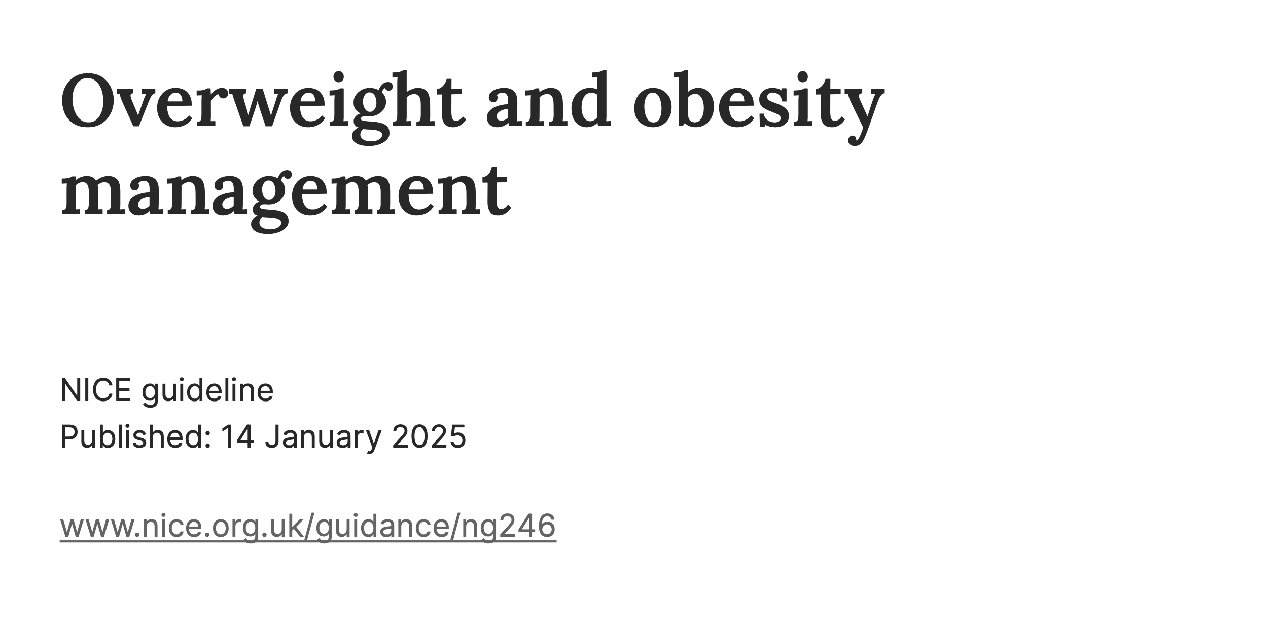

Samira Lekhal

Slide 4
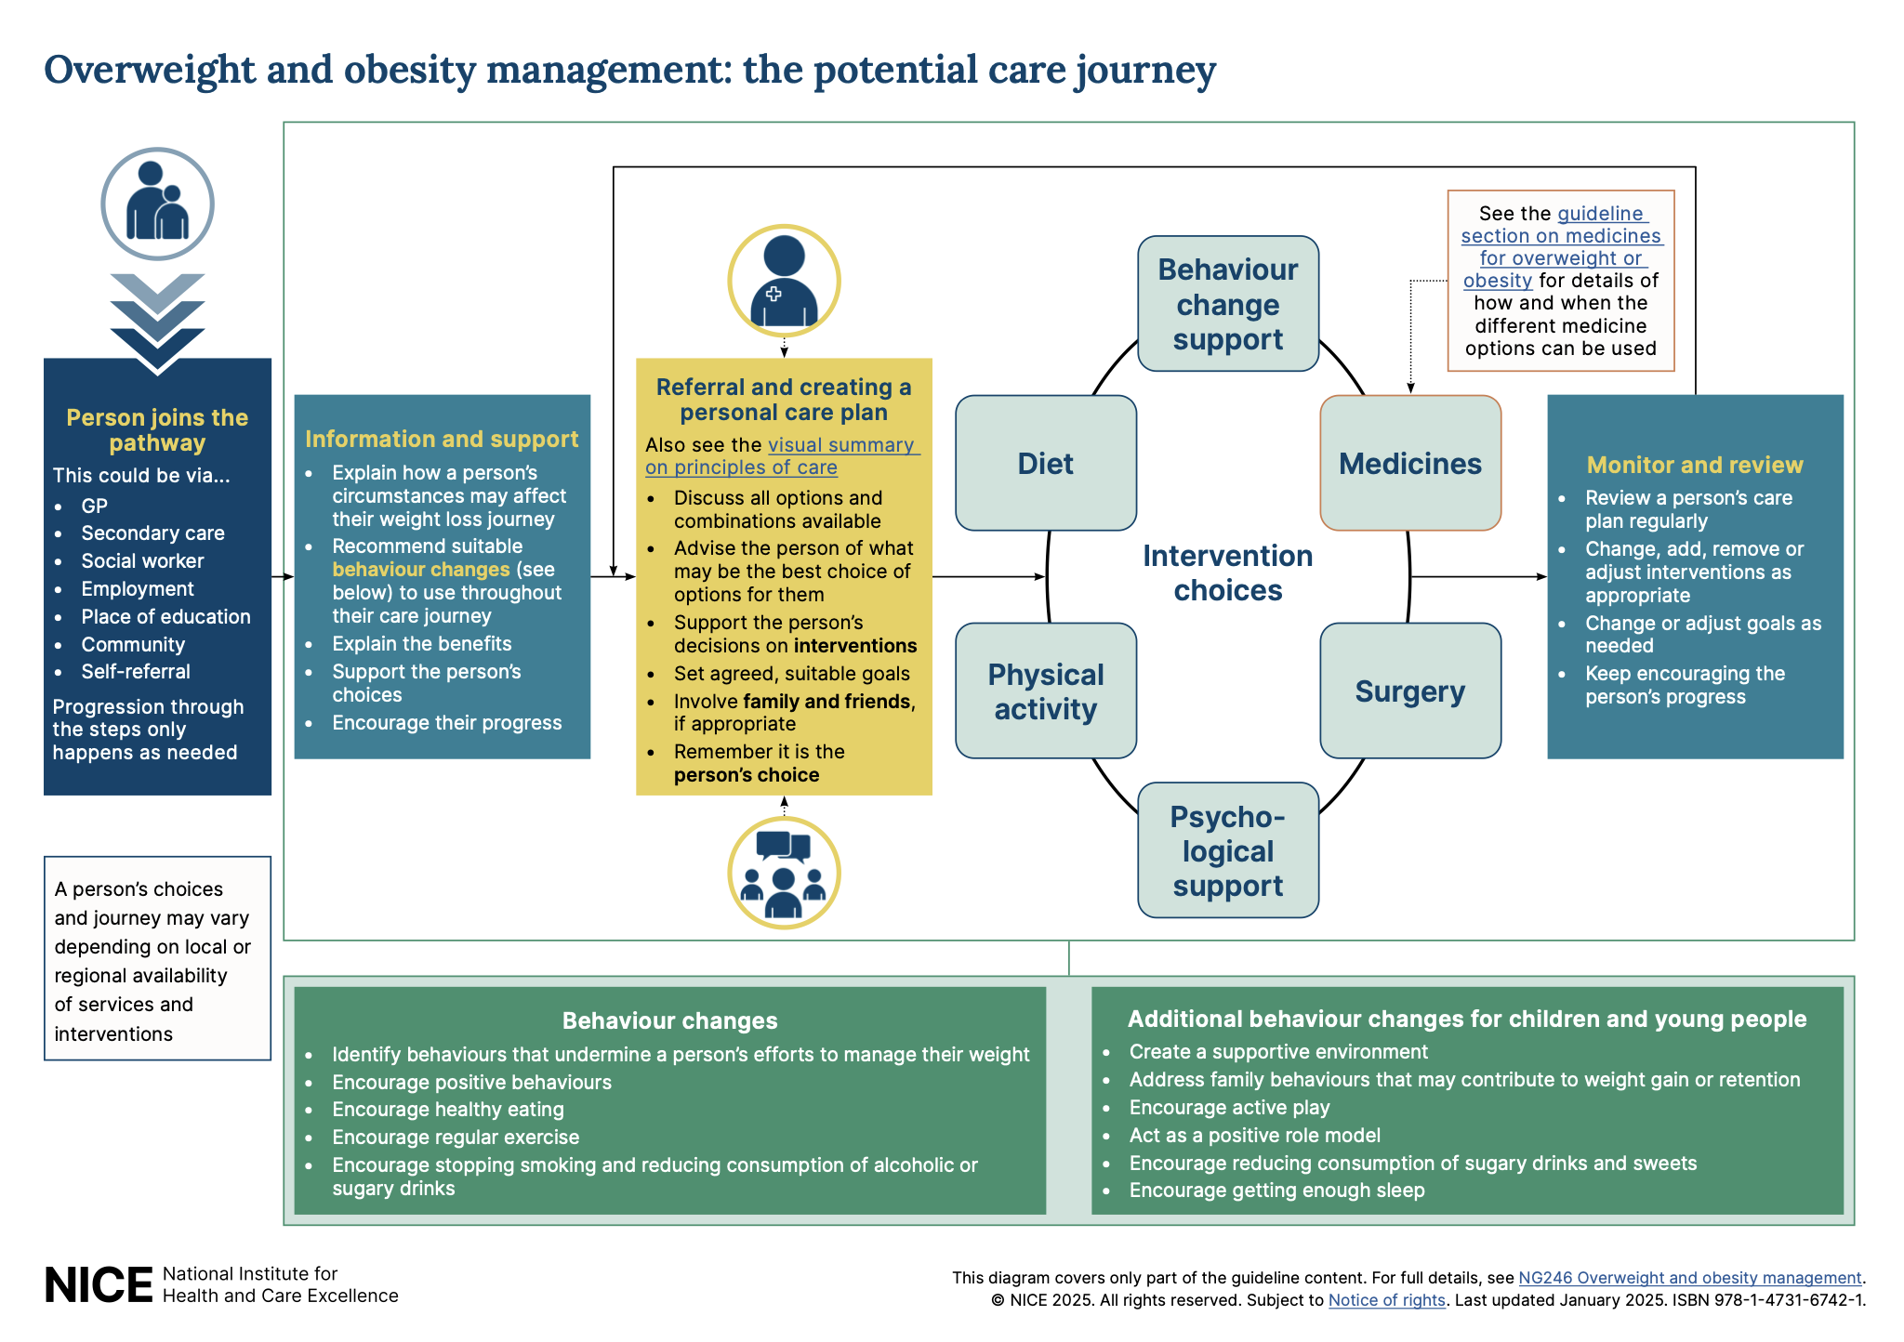
Samira Lekhal
Notes:
I dag har vi satt av tid til å diskutere gpd kostholdsveielnidng.
Og først skal vi starte med punketet knyttet til hva som ofte er et hhinder for god veielnding

Slide 5
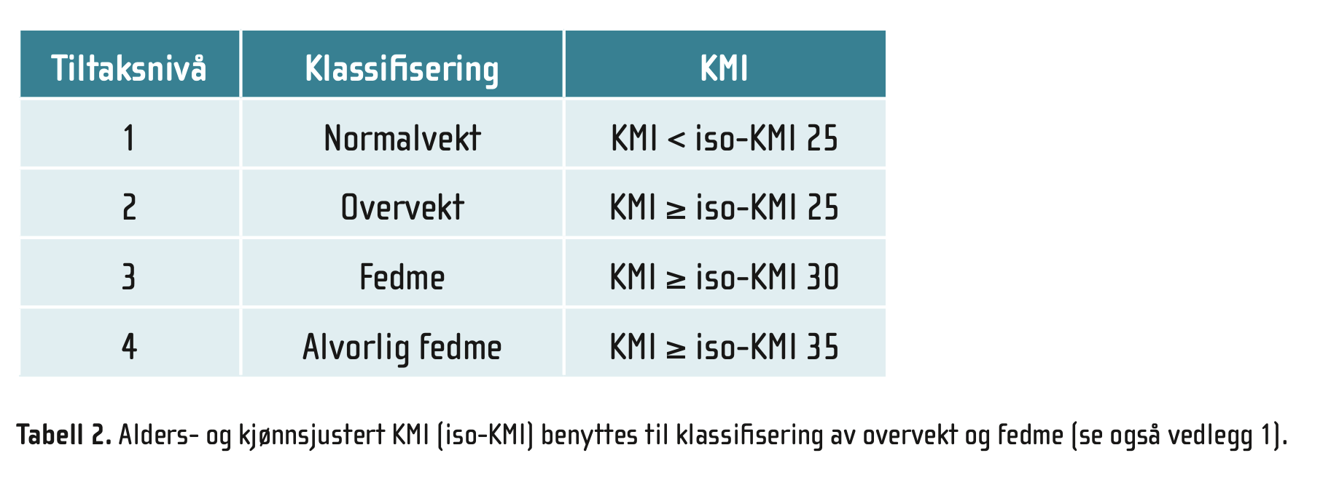
Hva er overvekt og fedme hos barn
Samira Lekhal

Slide 6
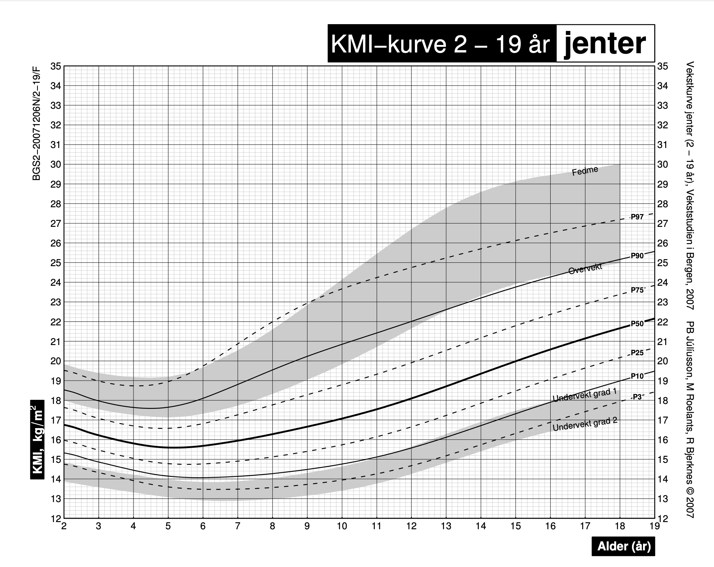
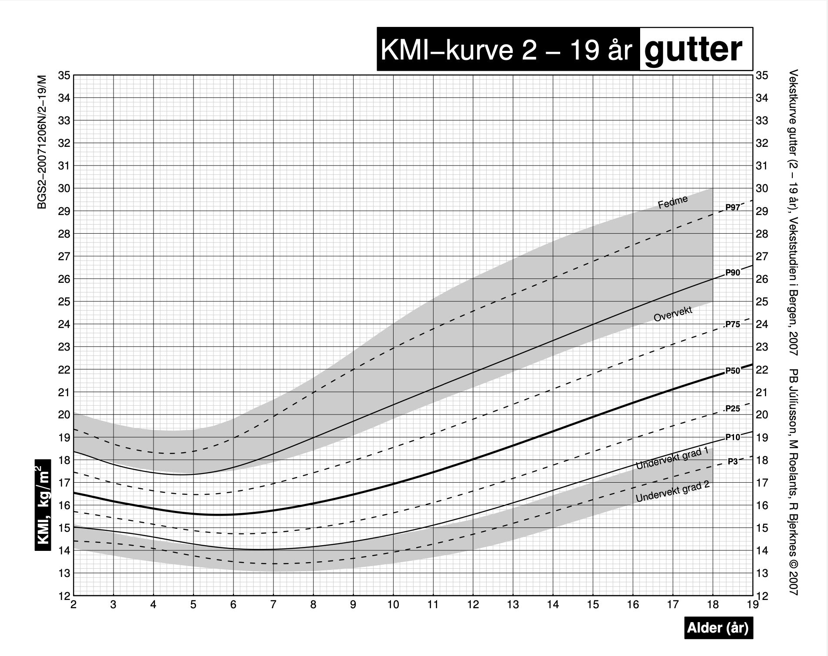
Samira Lekhal

Slide 7
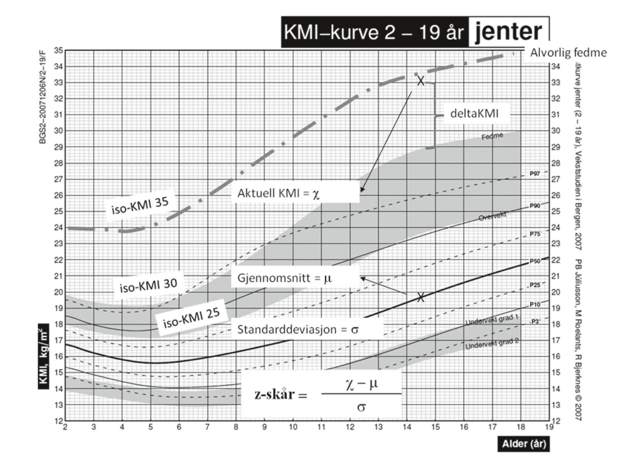
Samira Lekhal

Slide 8
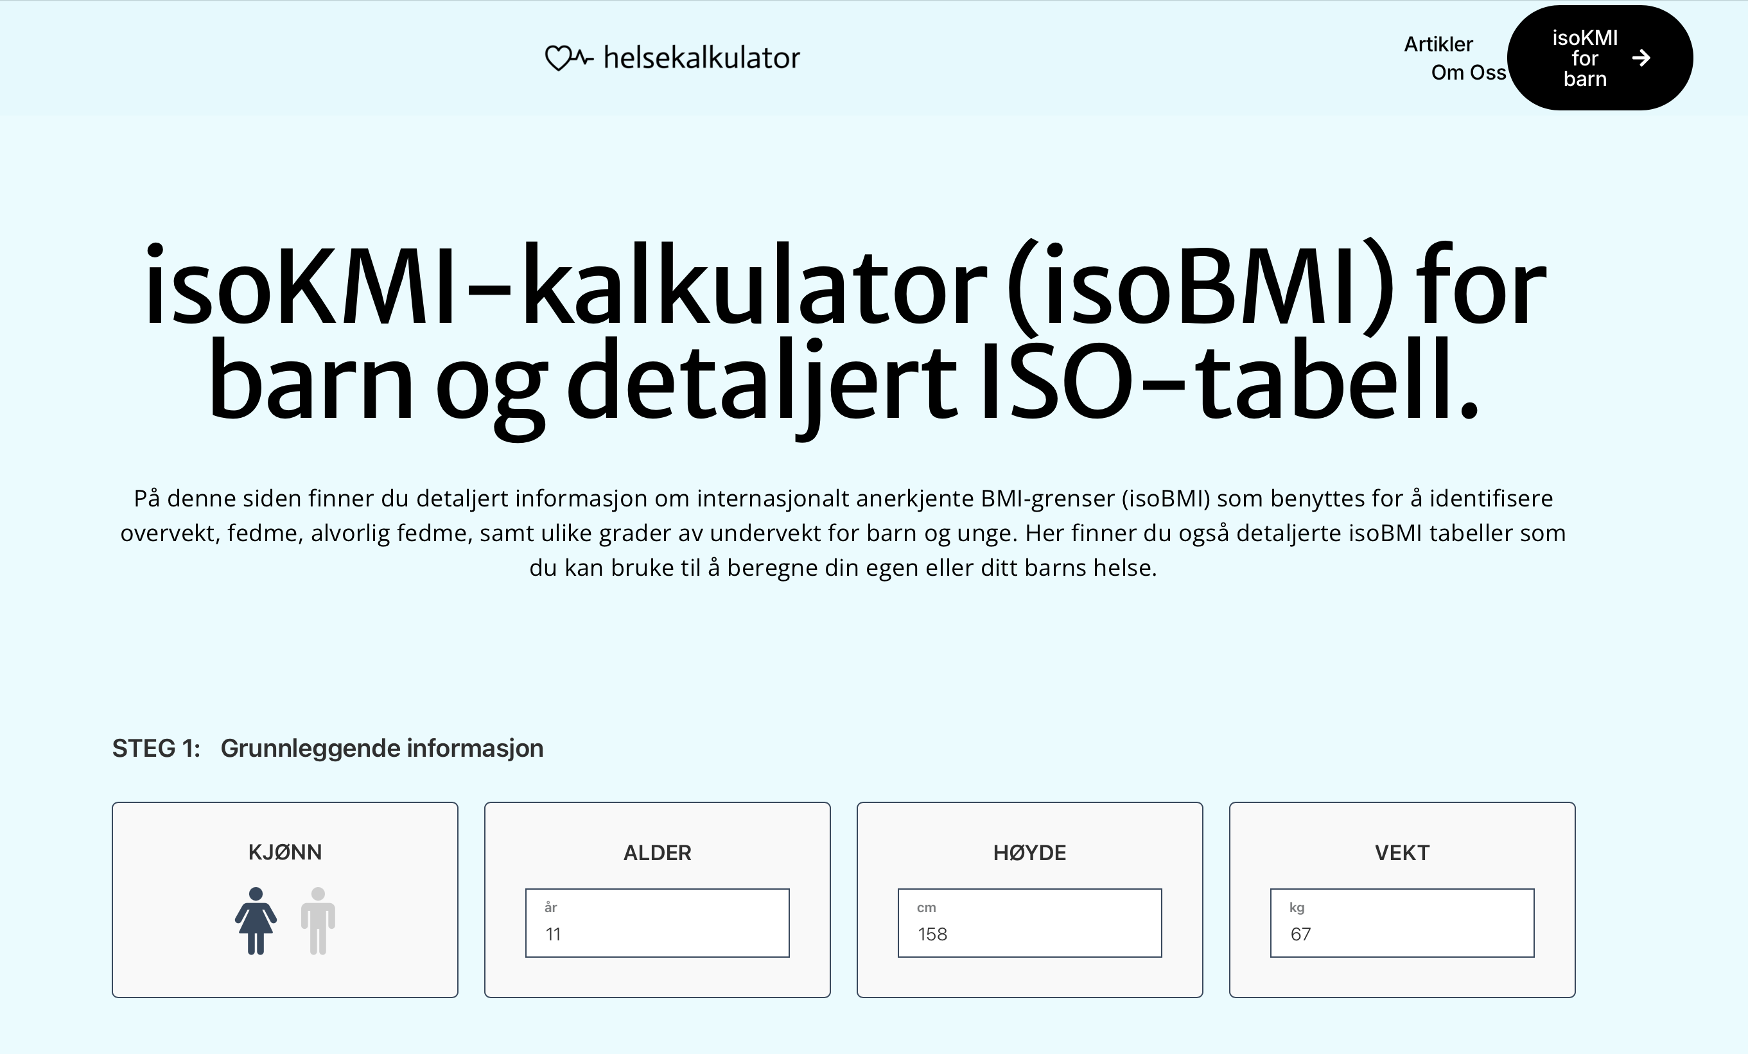
Samira Lekhal

Slide 9
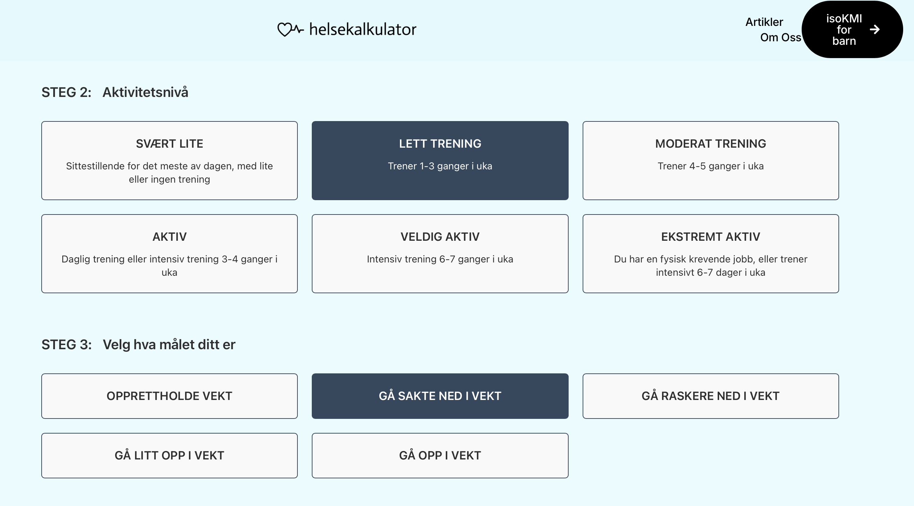
Samira Lekhal

Slide 10
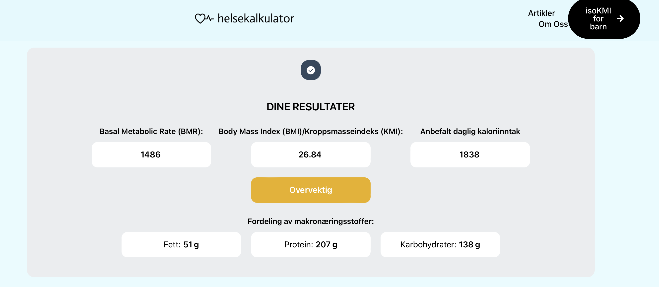
Samira Lekhal

Slide 11

Utredning og behandling
  Kostholdsveiledning
  Fysisk aktivitet
  Holdnings - og atferdsendring
  Medikamentell behandling
  Reinehr T. Nat Rev Endocrinol. 2013 Oct;9(10):607-14.. Epub 2013 Jul 30. Review
  Ho M. et al, Pediatrics 2012; 130:e 1647
  Oude et al., 2009, cochrane systemativ review
  Meade E. et al, 2017, Cochrane Databse Syst Rev
Samira Lekhal
Notes:
Utgangspunkt i Nasjonale retningslinjeg for kosthold og fysisk aktivitet, ALLTID
Kaloriunderskudd er hovedregel

Slide 12
Utredning og behandling
  Kartlegging
  Anamnese
    Vekthistorikk, genetisk disp
    Kostholdsvaner
  Klinisk us
    H, V, iso BMI, midjemål, BT
  Orienterende blodprøver
  Reinehr T. Nat Rev Endocrinol. 2013 Oct;9(10):607-14.. Epub 2013 Jul 30. Review
  Ho M. et al, Pediatrics 2012; 130:e 1647
  Oude et al., 2009, cochrane systemativ review
  Meade E. et al, 2017, Cochrane Databse Syst Rev
Samira Lekhal
Notes:
Utgangspunkt i Nasjonale retningslinjeg for kosthold og fysisk aktivitet, ALLTID
Kaloriunderskudd er hovedregel

Slide 13
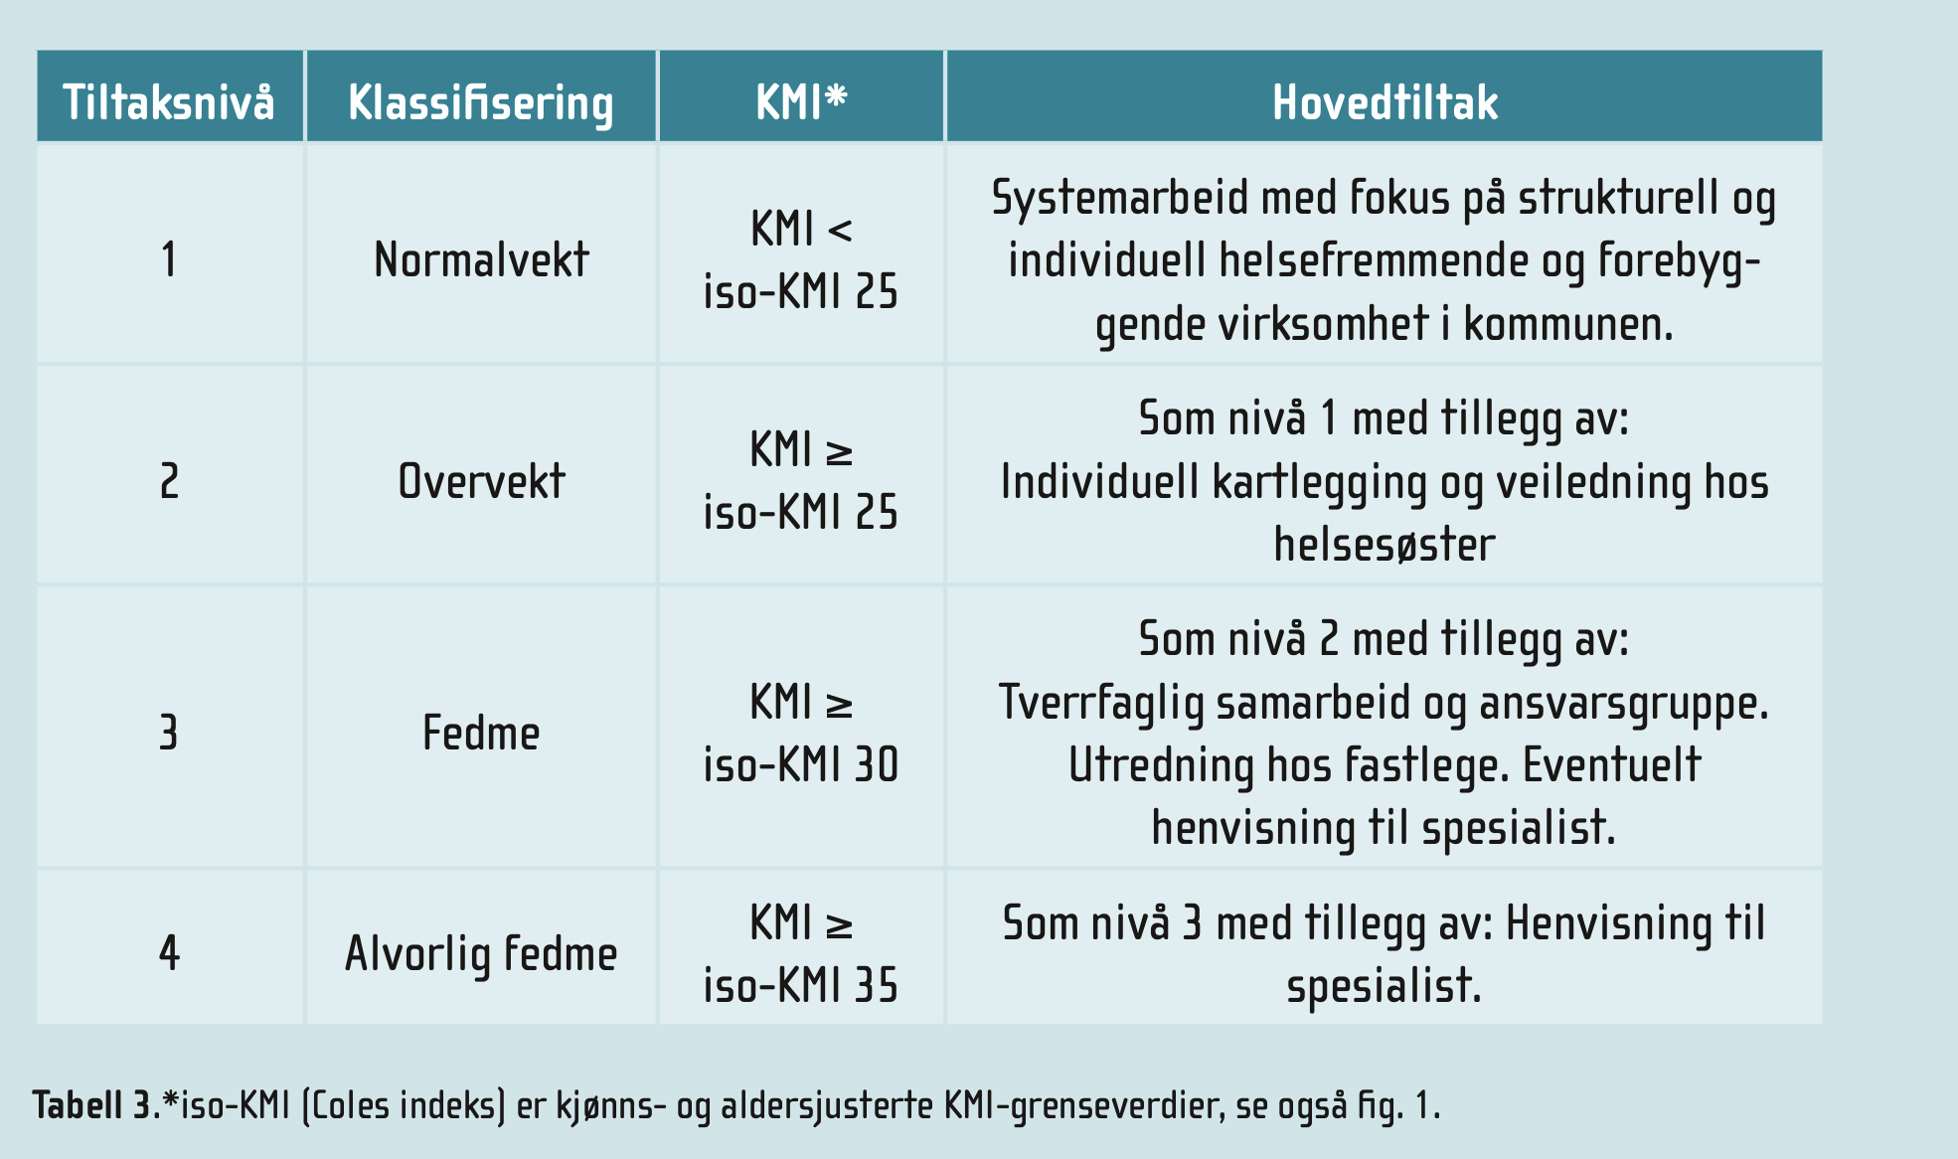
Samira Lekhal
Notes:
In this randomized, double-blind trial, which consisted of a 56-week treatment period and a 26-week follow-up period, we enrolled adolescents (12 to <18 years of age) with obesity and a poor response to lifestyle therapy alone. Participants were randomly assigned (1:1) to receive either liraglutide (3.0 mg) or placebo sub- cutaneously once daily, in addition to lifestyle therapy. The primary end point was the change from baseline in the body-mass index standard-deviation score at week 56

Slide 14
Utredning og behandling
  Kostholdsveiledning
  Fysisk aktivitet
  Holdnings - og atferdsendring
  Medikamentell behandling
  Reinehr T. Nat Rev Endocrinol. 2013 Oct;9(10):607-14.. Epub 2013 Jul 30. Review
  Ho M. et al, Pediatrics 2012; 130:e 1647
  Oude et al., 2009, cochrane systemativ review
  Meade E. et al, 2017, Cochrane Databse Syst Rev
Samira Lekhal
Notes:
Utgangspunkt i Nasjonale retningslinjeg for kosthold og fysisk aktivitet, ALLTID
Kaloriunderskudd er hovedregel

Slide 15
Kostholdsveiledning for barn - fokus
  Måltidsrytme
  Porsjon størrelse
  Søte drikker
  Tilgjengelighet av mat
  Emosjonell spising
Samira Lekhal
Notes:
In this randomized, double-blind trial, which consisted of a 56-week treatment period and a 26-week follow-up period, we enrolled adolescents (12 to <18 years of age) with obesity and a poor response to lifestyle therapy alone. Participants were randomly assigned (1:1) to receive either liraglutide (3.0 mg) or placebo sub- cutaneously once daily, in addition to lifestyle therapy. The primary end point was the change from baseline in the body-mass index standard-deviation score at week 56

Slide 16
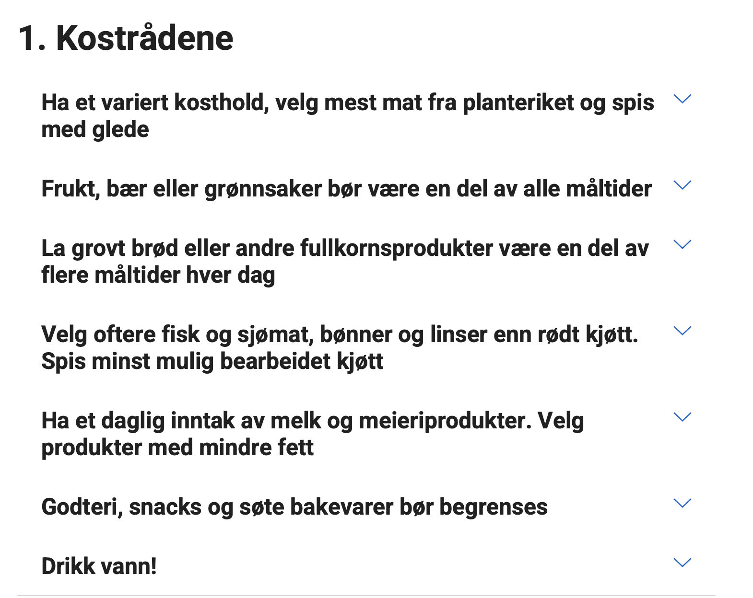
Optimal og effektiv livsstilsbehandling
  Kostholdsveiledning
    Regelmessige måltider
    Porsjon størrelse
    Kaloririk drikke
    Tilgjengelighet av næringstett mat
    Emosjonell spising
Samira Lekhal
Notes:
Utgangspunkt i Nasjonale retningslinjeg for kosthold og fysisk aktivitet, ALLTID
Kaloriunderskudd er hovedregel

Slide 17
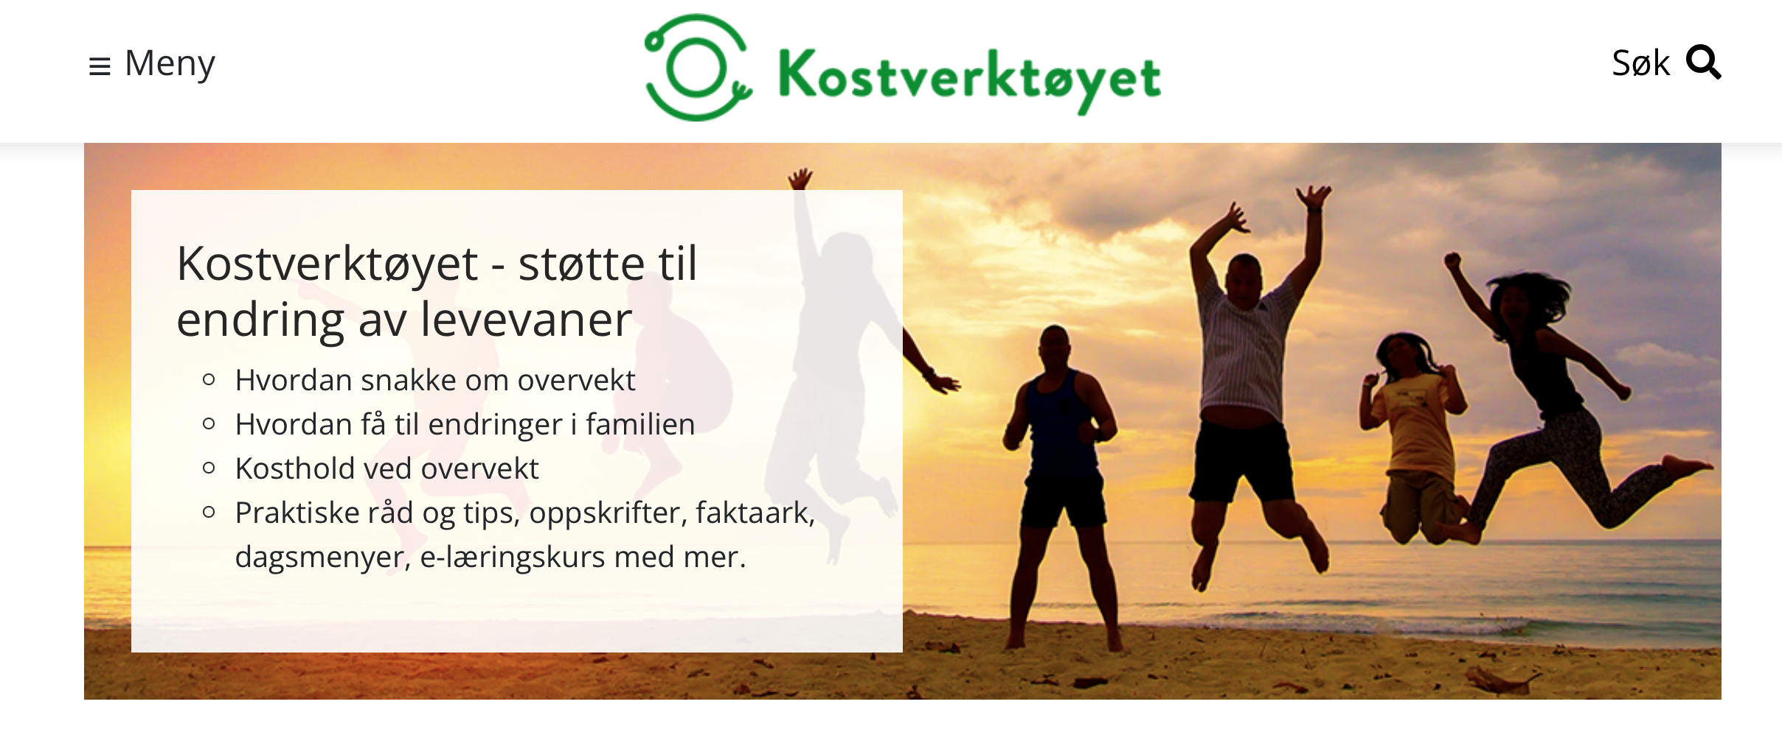
Samira Lekhal
Notes:
In this randomized, double-blind trial, which consisted of a 56-week treatment period and a 26-week follow-up period, we enrolled adolescents (12 to <18 years of age) with obesity and a poor response to lifestyle therapy alone. Participants were randomly assigned (1:1) to receive either liraglutide (3.0 mg) or placebo sub- cutaneously once daily, in addition to lifestyle therapy. The primary end point was the change from baseline in the body-mass index standard-deviation score at week 56

Slide 18
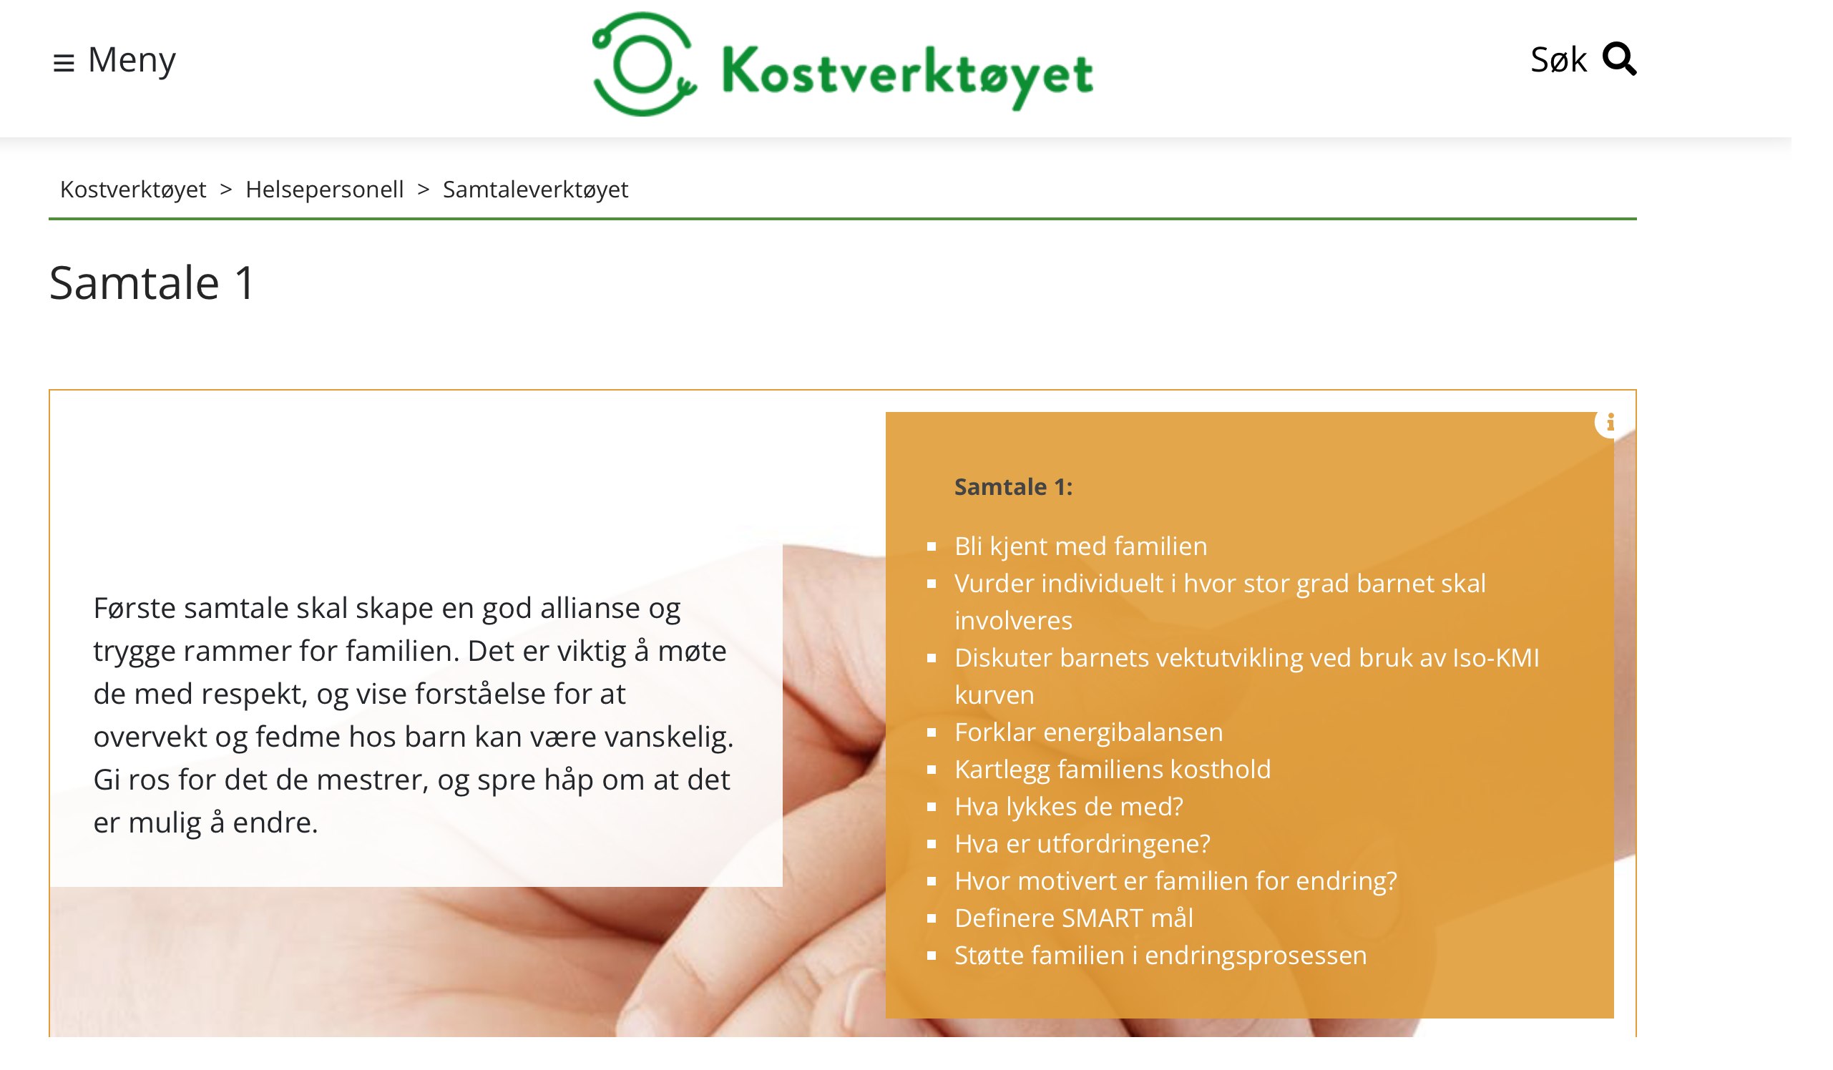
Samira Lekhal
Notes:
In this randomized, double-blind trial, which consisted of a 56-week treatment period and a 26-week follow-up period, we enrolled adolescents (12 to <18 years of age) with obesity and a poor response to lifestyle therapy alone. Participants were randomly assigned (1:1) to receive either liraglutide (3.0 mg) or placebo sub- cutaneously once daily, in addition to lifestyle therapy. The primary end point was the change from baseline in the body-mass index standard-deviation score at week 56

Slide 19
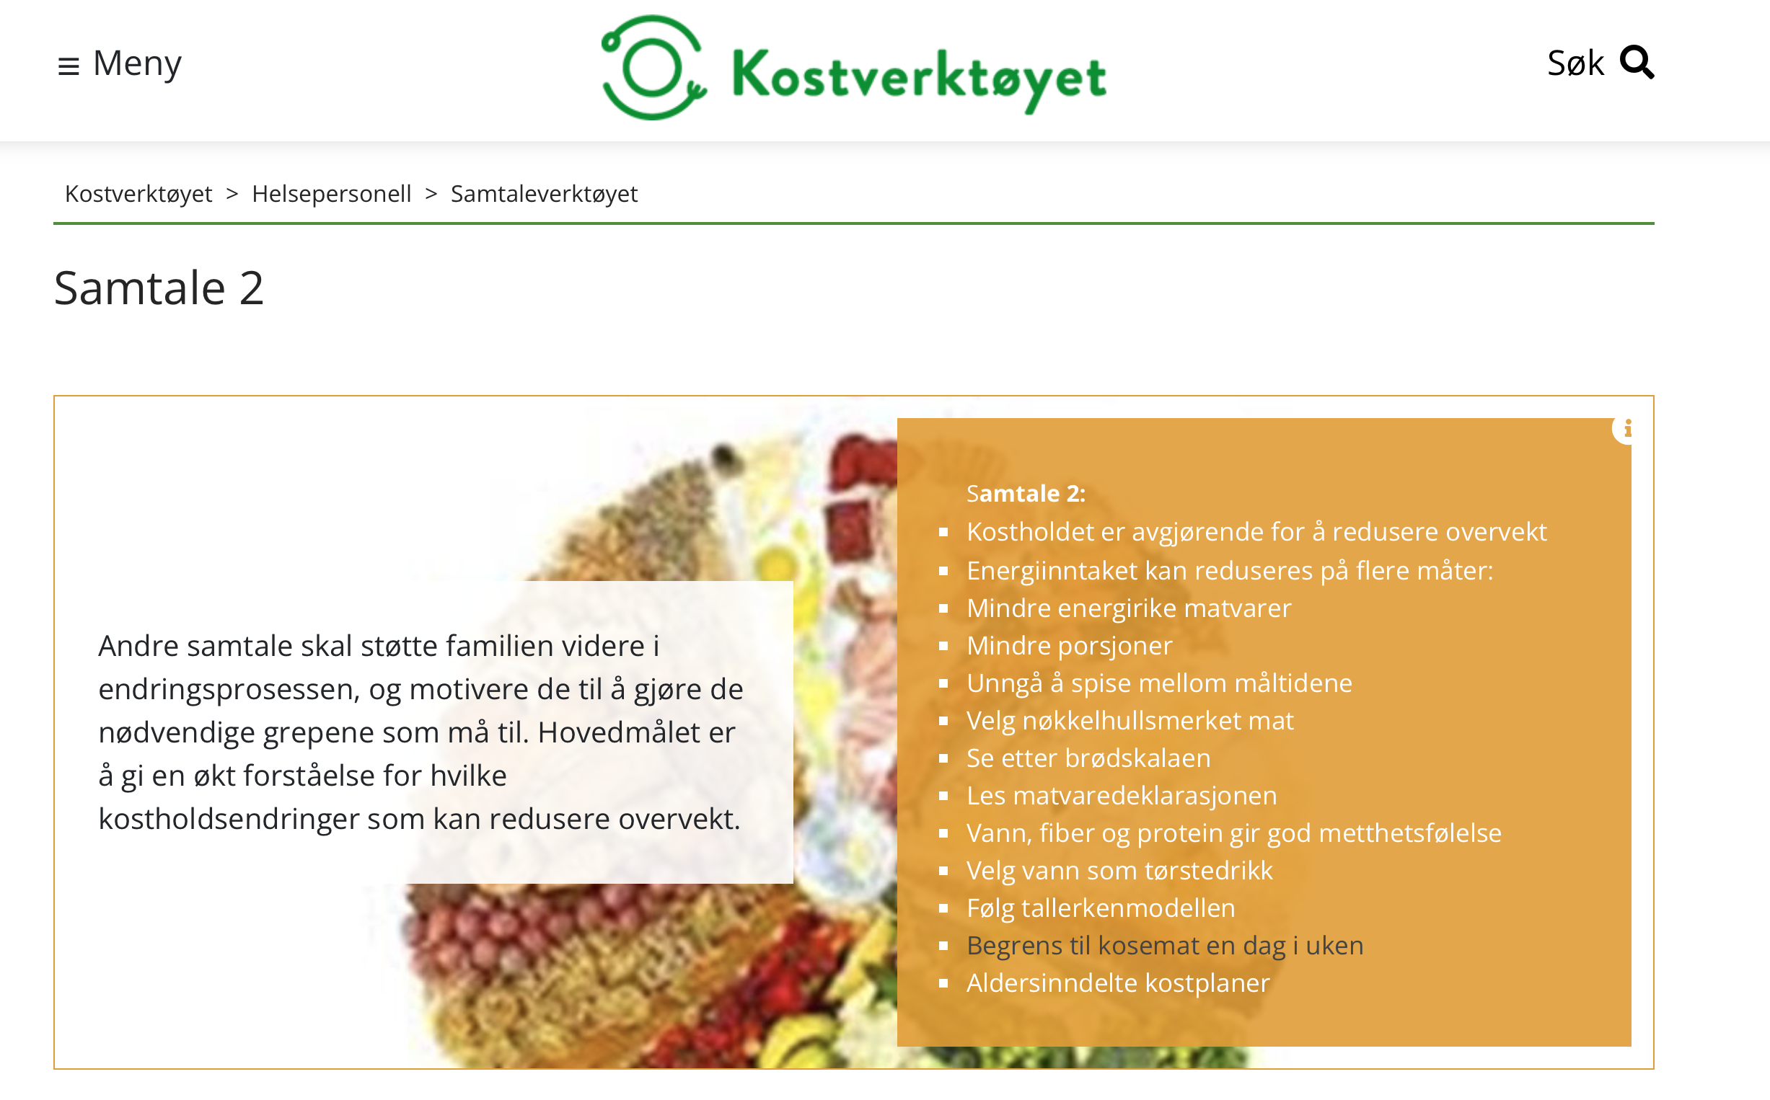
Samira Lekhal
Notes:
In this randomized, double-blind trial, which consisted of a 56-week treatment period and a 26-week follow-up period, we enrolled adolescents (12 to <18 years of age) with obesity and a poor response to lifestyle therapy alone. Participants were randomly assigned (1:1) to receive either liraglutide (3.0 mg) or placebo sub- cutaneously once daily, in addition to lifestyle therapy. The primary end point was the change from baseline in the body-mass index standard-deviation score at week 56

Slide 20
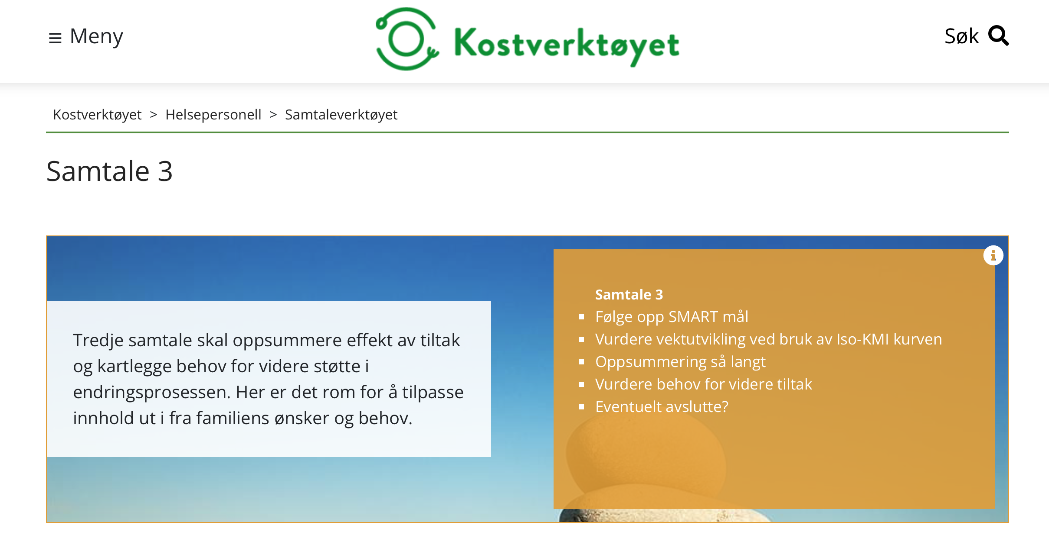
Samira Lekhal
Notes:
In this randomized, double-blind trial, which consisted of a 56-week treatment period and a 26-week follow-up period, we enrolled adolescents (12 to <18 years of age) with obesity and a poor response to lifestyle therapy alone. Participants were randomly assigned (1:1) to receive either liraglutide (3.0 mg) or placebo sub- cutaneously once daily, in addition to lifestyle therapy. The primary end point was the change from baseline in the body-mass index standard-deviation score at week 56

Slide 21
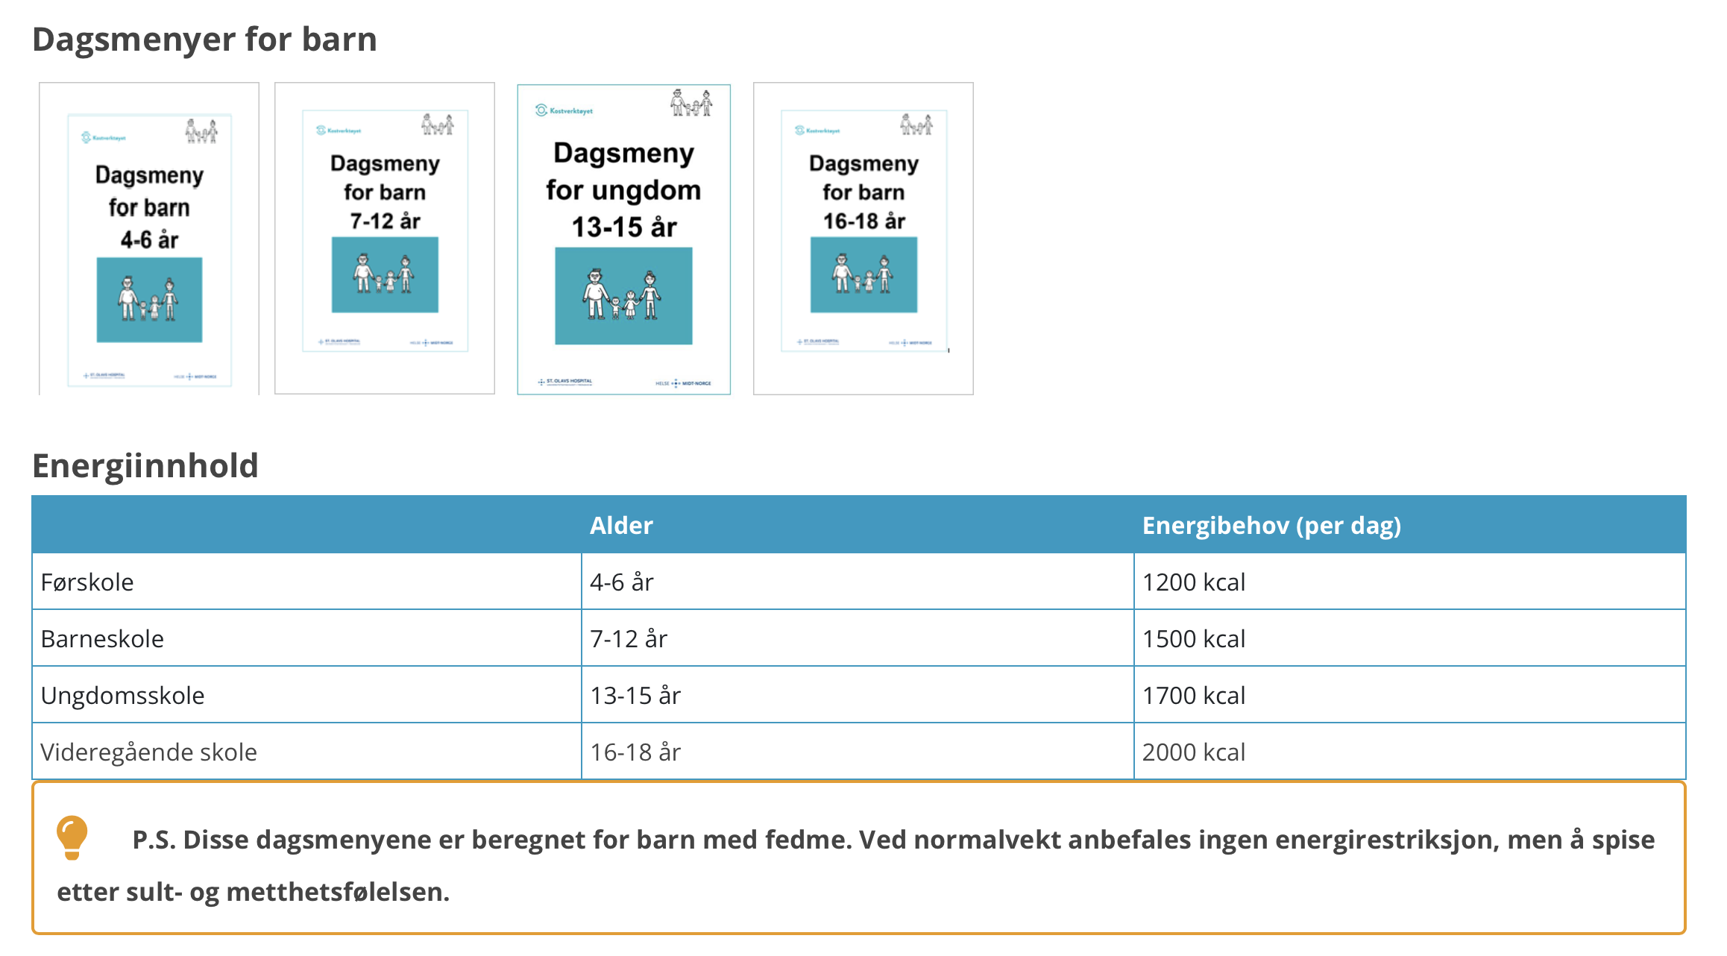
Kostholdsveiledning for barn og unge
Samira Lekhal

Slide 22
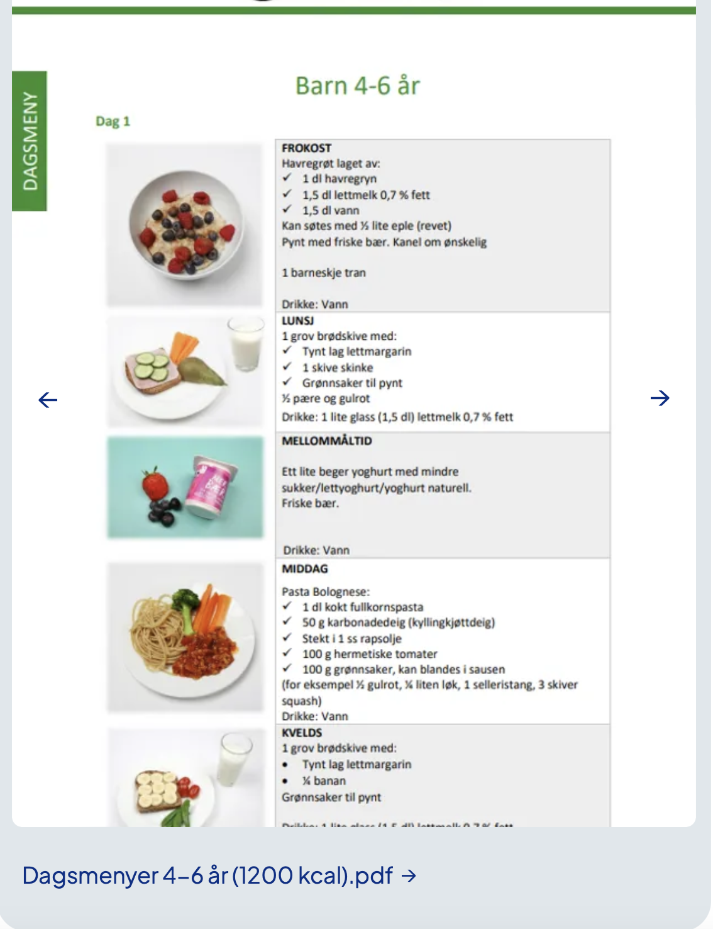
Kostholdsveiledning for barn - fokus
Samira Lekhal
Notes:
In this randomized, double-blind trial, which consisted of a 56-week treatment period and a 26-week follow-up period, we enrolled adolescents (12 to <18 years of age) with obesity and a poor response to lifestyle therapy alone. Participants were randomly assigned (1:1) to receive either liraglutide (3.0 mg) or placebo sub- cutaneously once daily, in addition to lifestyle therapy. The primary end point was the change from baseline in the body-mass index standard-deviation score at week 56

Slide 23
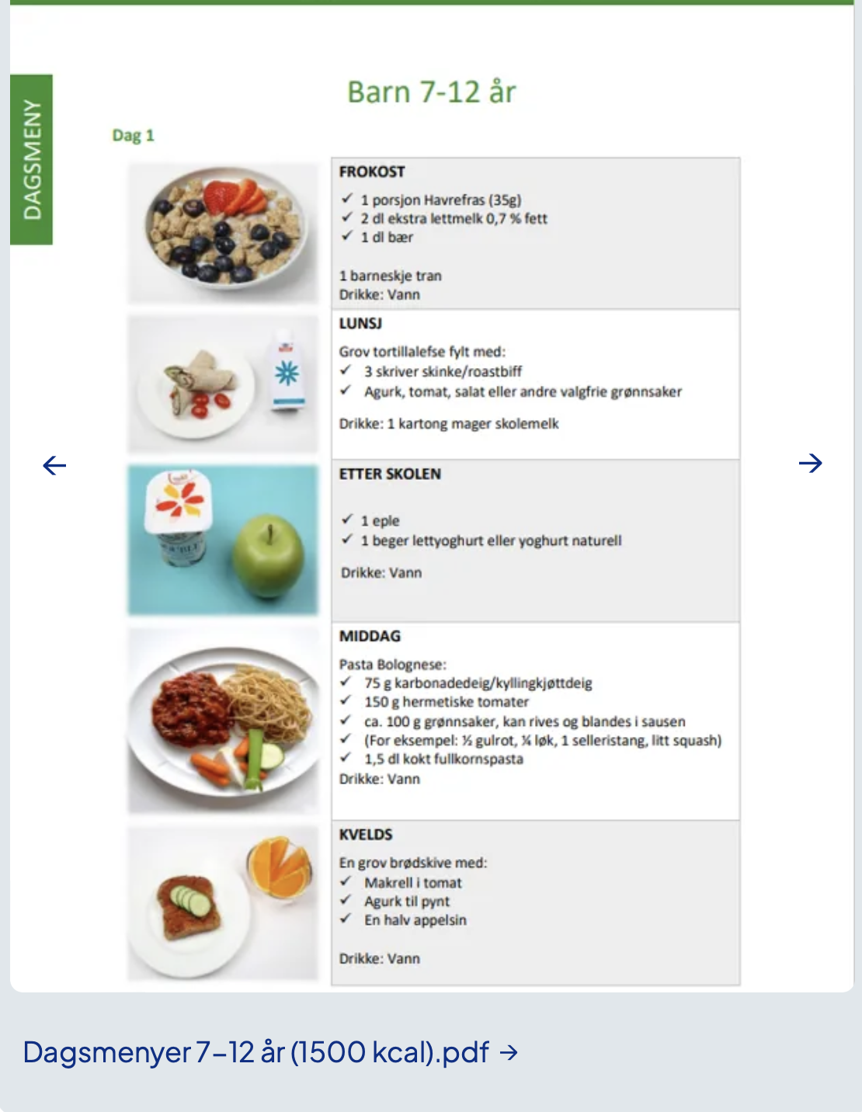
Kostholdsveiledning for barn - fokus
Samira Lekhal
Notes:
In this randomized, double-blind trial, which consisted of a 56-week treatment period and a 26-week follow-up period, we enrolled adolescents (12 to <18 years of age) with obesity and a poor response to lifestyle therapy alone. Participants were randomly assigned (1:1) to receive either liraglutide (3.0 mg) or placebo sub- cutaneously once daily, in addition to lifestyle therapy. The primary end point was the change from baseline in the body-mass index standard-deviation score at week 56

Slide 24
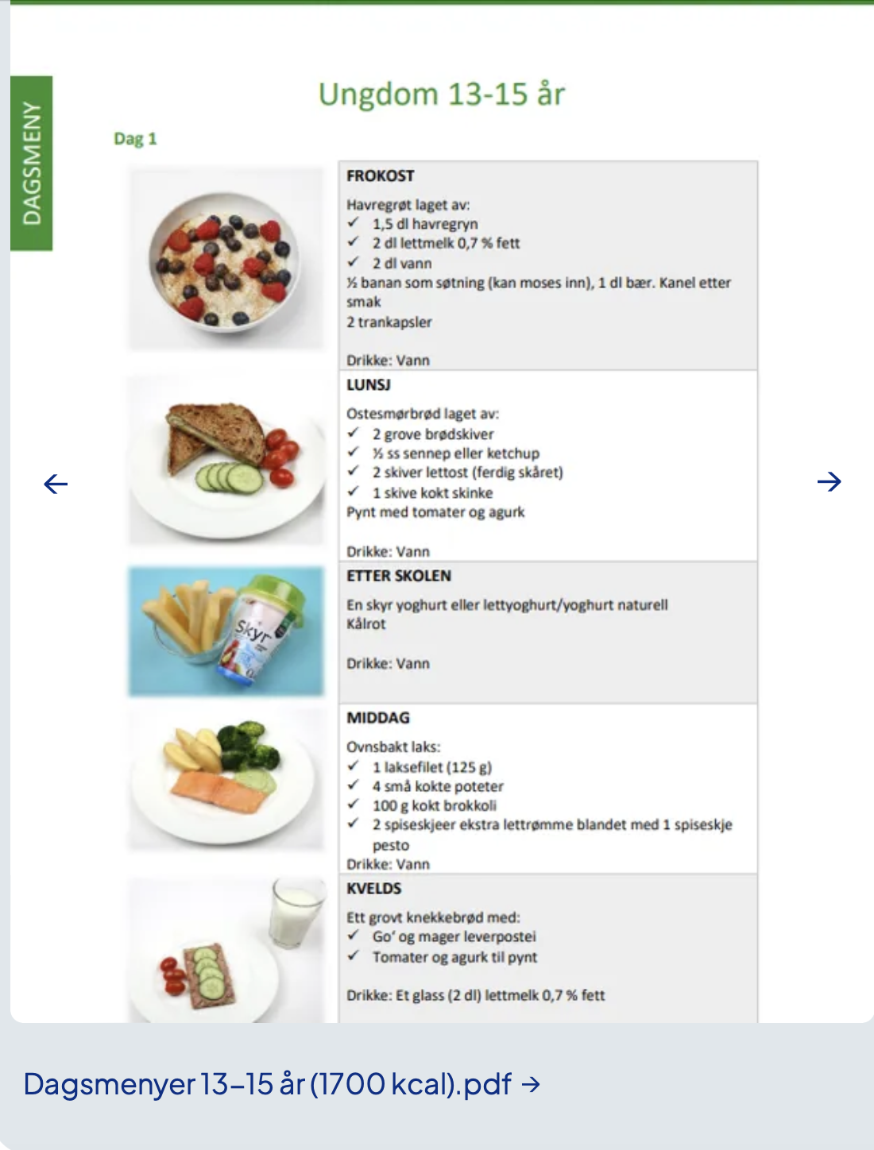
Kostholdsveiledning for barn - fokus
Samira Lekhal
Notes:
In this randomized, double-blind trial, which consisted of a 56-week treatment period and a 26-week follow-up period, we enrolled adolescents (12 to <18 years of age) with obesity and a poor response to lifestyle therapy alone. Participants were randomly assigned (1:1) to receive either liraglutide (3.0 mg) or placebo sub- cutaneously once daily, in addition to lifestyle therapy. The primary end point was the change from baseline in the body-mass index standard-deviation score at week 56

Slide 25
Hvordan håndtere sult?
  Regelmessige måltider
  Protein og fiber rikt
  Plan for mengde
  Grensesetting
Samira Lekhal
Notes:
Husk de 5 vanligste urdoringenen

Slide 26
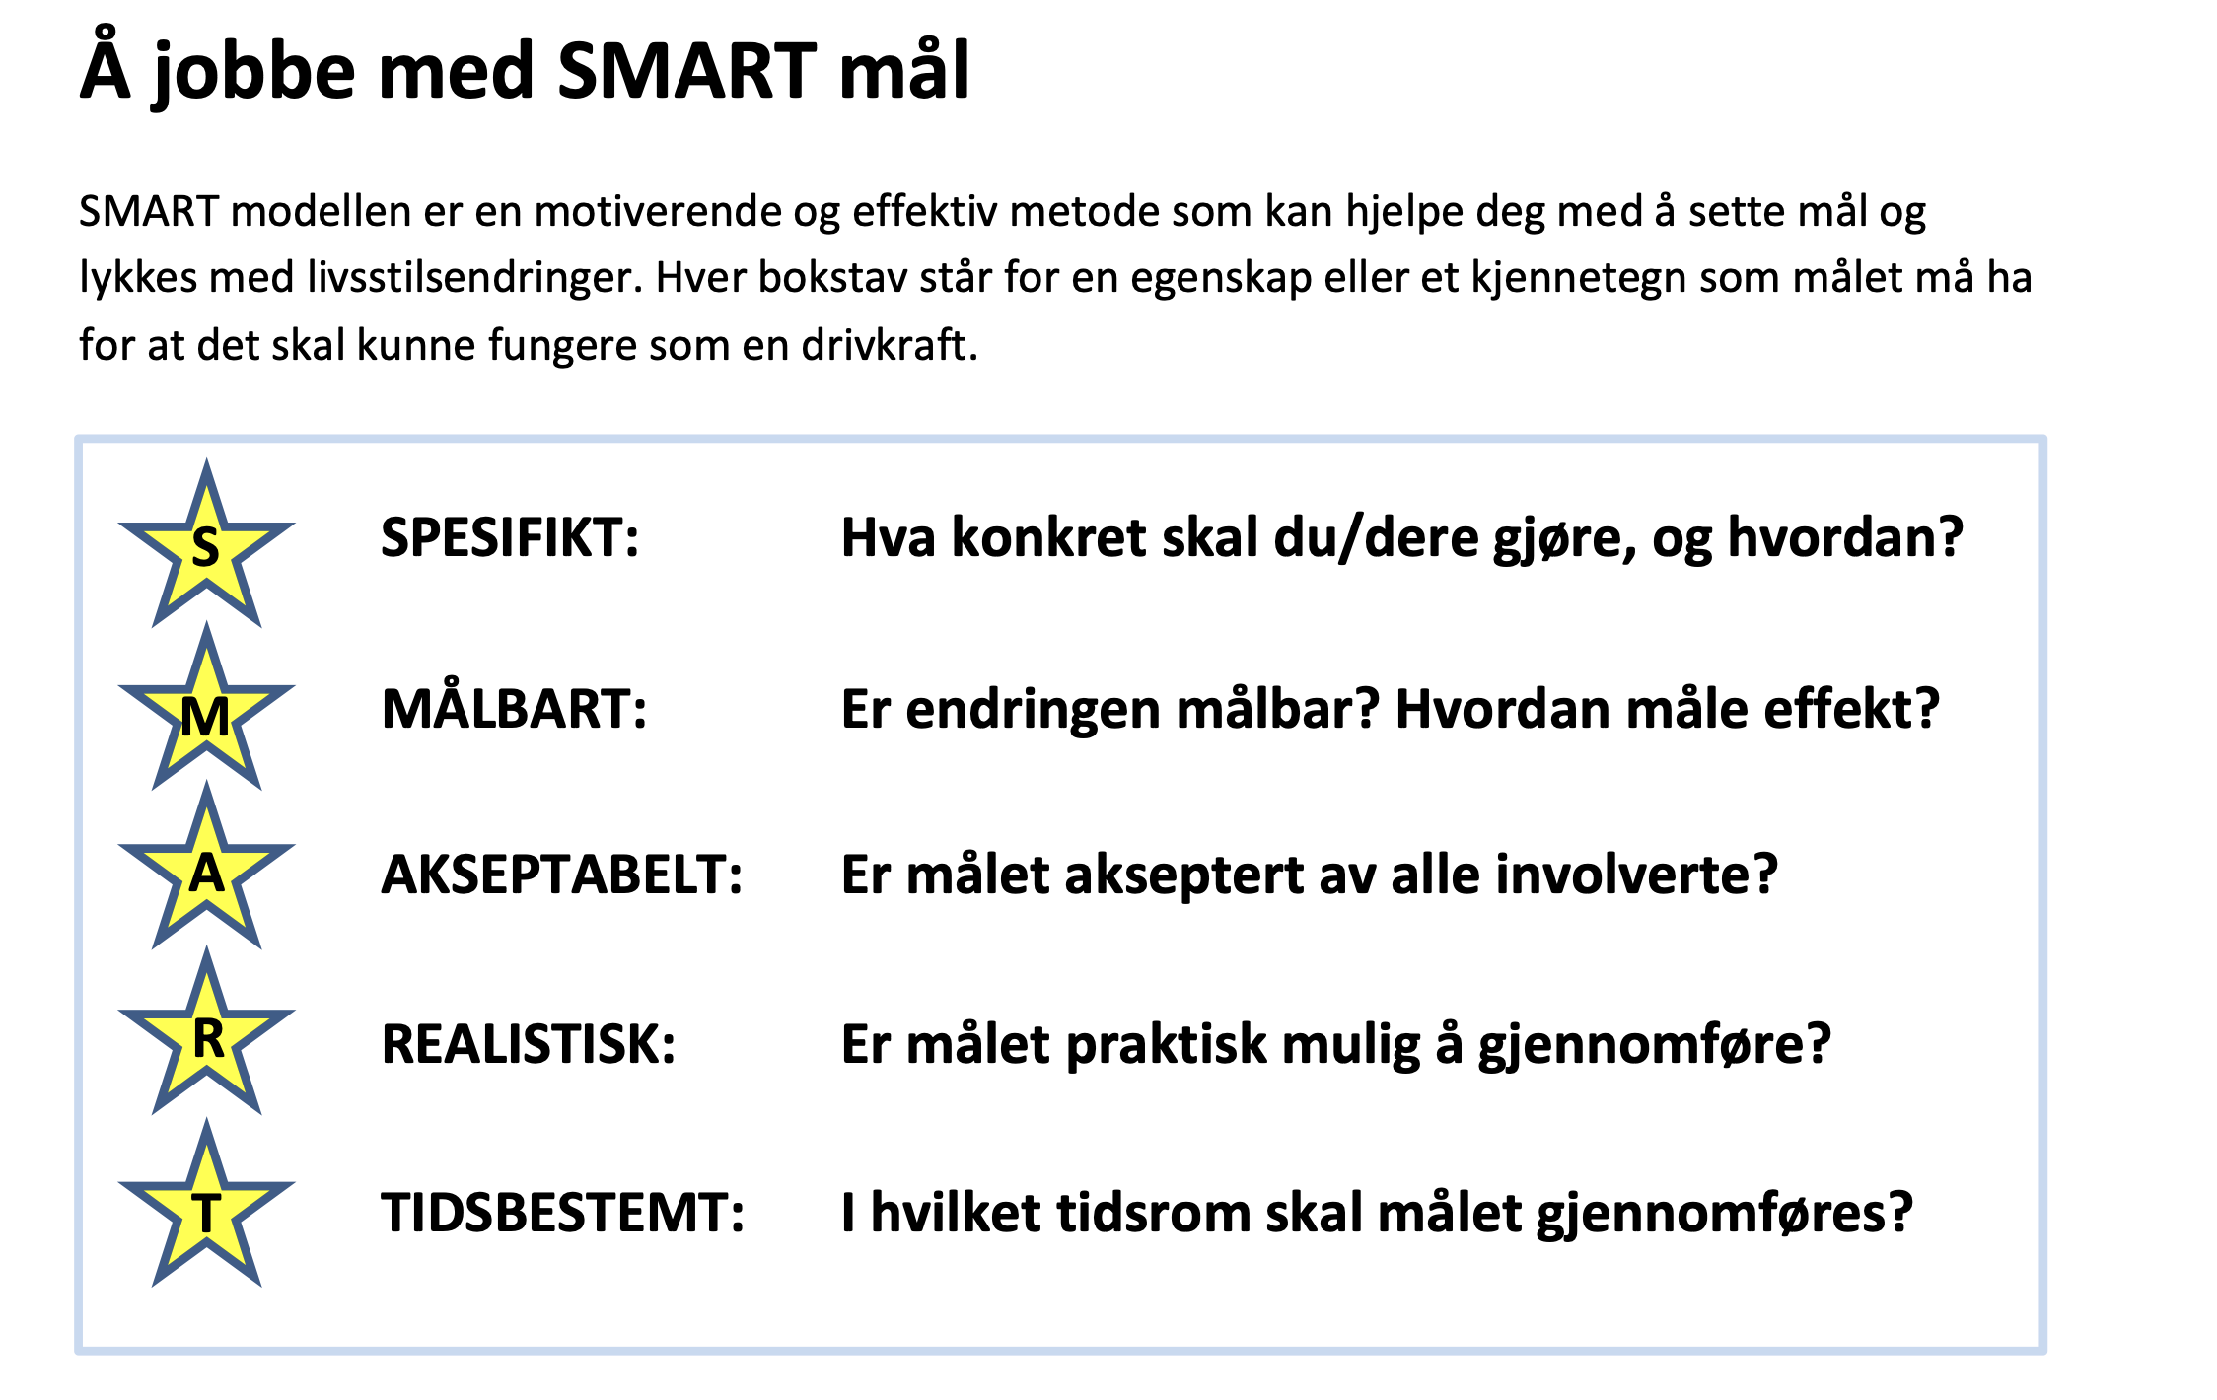
SMART mål
Samira Lekhal

Slide 27
SMARTe kostholdsmål
  Måltidsrytme
  Porsjon størrelse
  Søte drikker
  Tilgjengelighet av mat
  Emosjonell spising
Samira Lekhal
Notes:
Husk de 5 vanligste urdoringenen

Slide 28
Kresne barn
  1 av 4 barn er særs kresne i matveien i alderen 4-6 år
  Predisponerte hvis sensitive foreldre og barn
  Tiltak
    Nysgjerrighet og lek med mat
    Sult skaper økt toleranse for smak
    Repeterende smak (15)
Referanse:
Steinsbekk, S. m.fl: Child and parent predictors of picky eating from preschool to school age. The International journal of behavioral nutrition and physical activity. (2018)
Samira Lekhal
Notes:
Husk de 5 vanligste urdoringenen

Slide 29
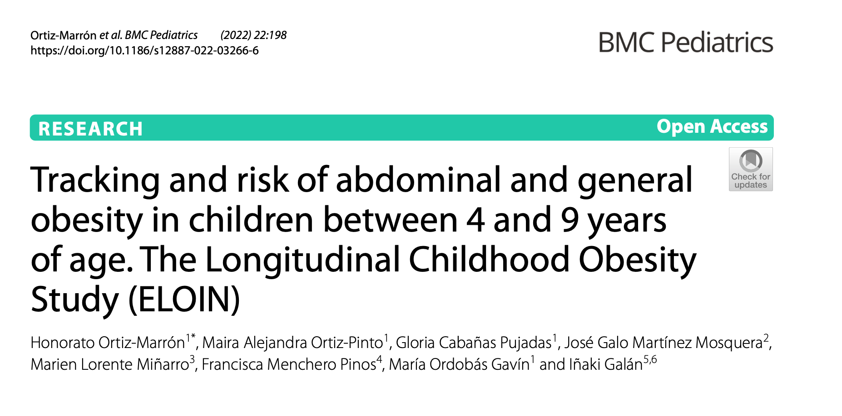
Barn vokser ikke ut av sin fedme
Among participants with general or abdominal obesity at 4 years of age, 77.3% and 63.6% remained in their obesity classification at 9 years.
Samira Lekhal
Notes:
The findings suggested that childhood obesity is significantly and positively associated with adult SBP (Zr = 0.11; 95% CI: 0.07, 0.14), DBP (Zr = 0.11; 95% CI: 0.07, 0.14), and TG (Zr =0.08; 95% CI: 0.03, 0.13), and significantly and inversely associated with adult HDL (Zr = −0.06; 95% CI: -0.10, −0.02). For those studies that adjusted for adult body mass index (BMI), associations were reversed, suggesting that adult BMI may be a potential mediator. Nine studies had more than 33% of items that placed them at an increased risk for bias.

Slide 30
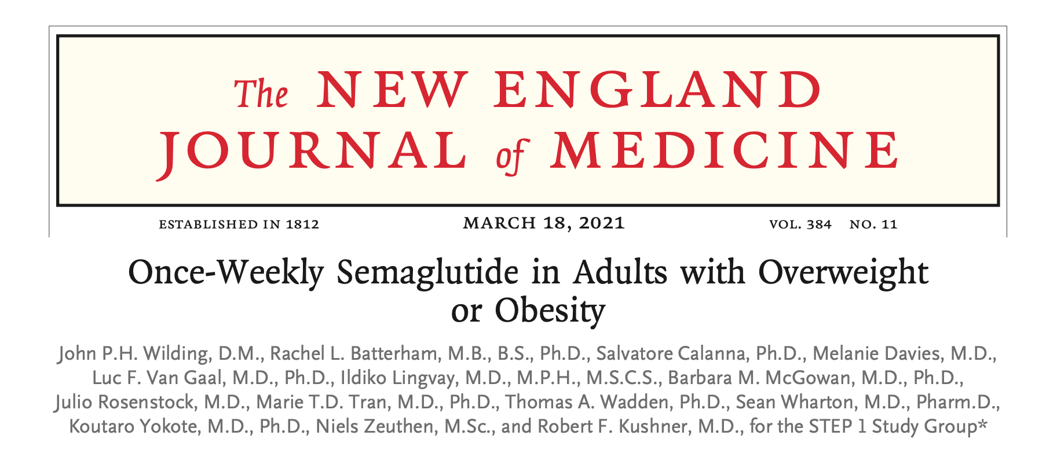
Ukentlig Semaglutid 2,4 mg, godkjent for ungdom over 12 år
12 % vektreduksjon i gjennomsnitt, totalt fulgt opp i 68 uker
Samira Lekhal
Notes:
In this randomized, double-blind trial, which consisted of a 56-week treatment period and a 26-week follow-up period, we enrolled adolescents (12 to <18 years of age) with obesity and a poor response to lifestyle therapy alone. Participants were randomly assigned (1:1) to receive either liraglutide (3.0 mg) or placebo sub- cutaneously once daily, in addition to lifestyle therapy. The primary end point was the change from baseline in the body-mass index standard-deviation score at week 56

Slide 31
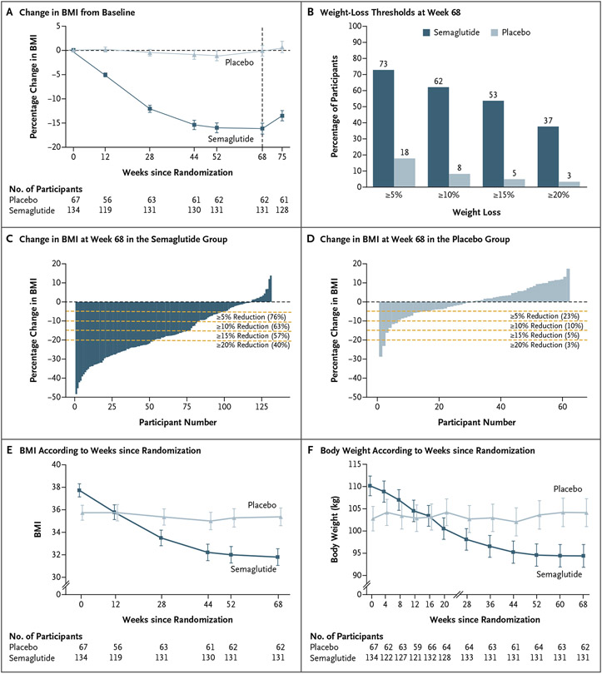
Samira Lekhal
Notes:
In this randomized, double-blind trial, which consisted of a 56-week treatment period and a 26-week follow-up period, we enrolled adolescents (12 to <18 years of age) with obesity and a poor response to lifestyle therapy alone. Participants were randomly assigned (1:1) to receive either liraglutide (3.0 mg) or placebo sub- cutaneously once daily, in addition to lifestyle therapy. The primary end point was the change from baseline in the body-mass index standard-deviation score at week 56

Slide 32
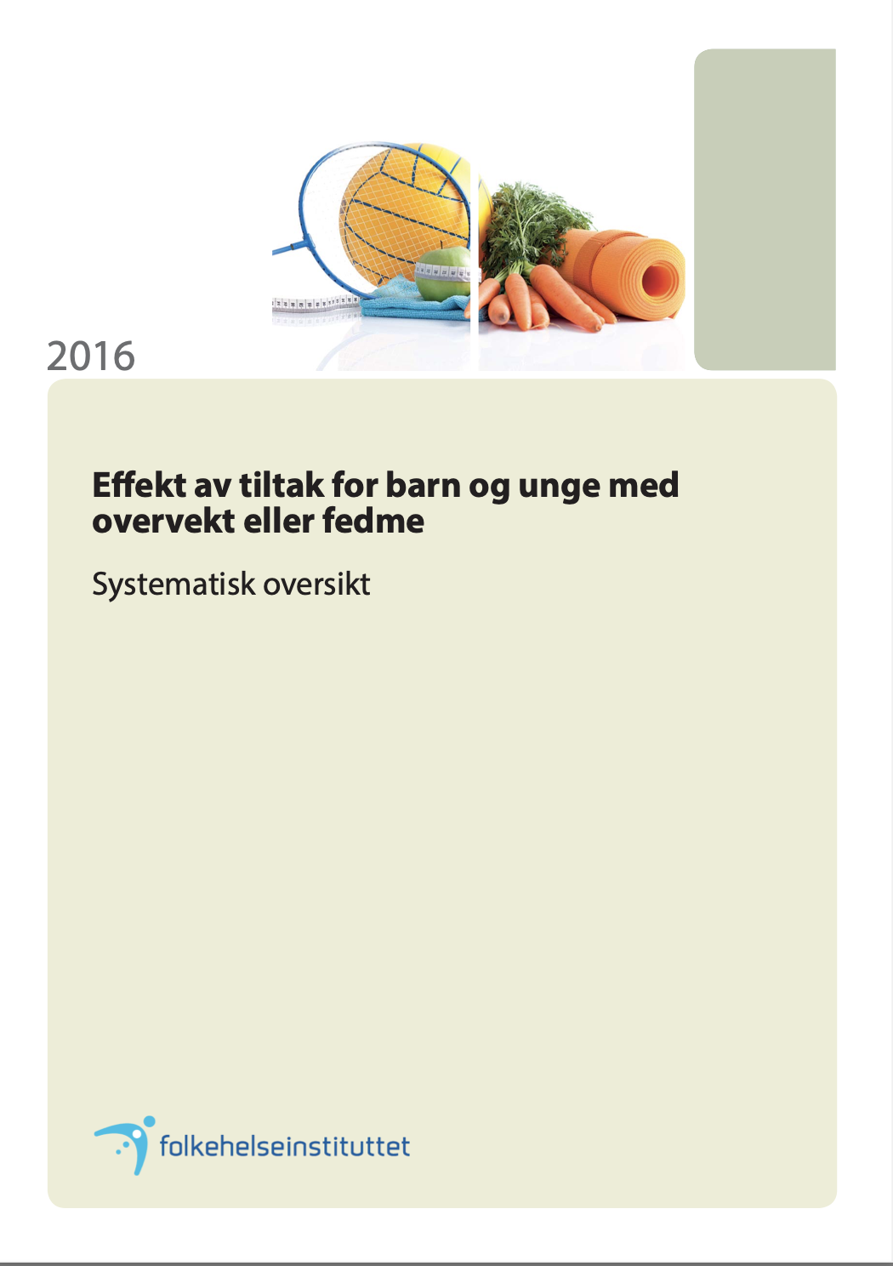
Hva er effektiv behandling?
Samira Lekhal
Notes:
Systemartisk oversikt Folkehelsa 2016

Slide 33
Hva er effektiv behandling?
  Behandlingsmål
    Stabil vekt med samtidig høyde vekst for barn under 12 år
    5-10 % vektreduksjon (BMI z skår, delta BMI) for barn over 12 år/pubertet
  Hindre videre økning i vekt
  Frafall betyr ikke at du/dere gir dårlig behandling
Referanse:
Elvsaas I-K Ø, Juvet LK, Giske L, Fure B. Effekt av tiltak for barn og unge med overvekt eller fedme. [Effectiveness of interventions for overweight or obesity in children and adolescents]. Rapport 2016. Oslo: Folkehelseinstituttet, 2016.
Samira Lekhal
Notes:
Frafall 0-50% er vanlig ref studier

Slide 34
Vi kan bare bli bedre!
Samira Lekhal

Slide 35
Og vi er så heldige at vi får være med på den reisen!
Samira Lekhal

Slide 36

TUSEN TAKK
Samira Lekhal

